Slide 1
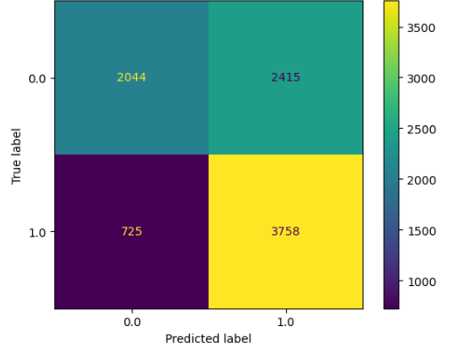
TikTok Claims Classification Project
Regression Analysis - Executive Summary
The TikTok data team is determined to develop to a machine learning model to assist with the classification of claims for user submissions.
Previously, the data team observed that if a user is verified, they are much more likely to post opinions. Since the goal is to classify claims and opinions, it is important to build a model that shows how to predict the behavior of the account type (verified,) that tend to post more opinions. The data team built a logistic model that predicts the verified_status
The variable of verified_status was chosen for this regression model because of the relationship seen between the verified account type and the video content. A logistic regression model was selected because of the data type and distribution
A LOOK AT THE MODEL RESULTS
The logistic regression model achieved a precision of 69% and a recall of 66% (weighted averages). This model achieved an f1 accuracy of 66%. These model results inform key insights on video features, discussed in “key insights”.
Based on the estimated model coefficient from the logistic regression, longer videos tend to be more associated with higher odds of being verified.
Other video features have small estimated coefficients in the model, so their association with verified status seems unlikely. Because of this, other video features besides video length are unable to be associated with verified status.
The next step is to construct a classification model that will predict the status of the claims made by the users. This will be the final project and original goal this process.
Now there is enough to analyze the results of that model with helpful context regarding user behavior.
The upper-left quadrant displays the number of true negatives: the number of videos posted by unverified accounts that the model accurately classified accordingly.
The upper-right quadrant displays the number of false positives: the number of videos posted by unverified accounts that the model misclassified as posted by verified accounts.
The lower-left quadrant displays the number of false negatives: the number of videos posted by verified accounts that the model misclassified as posted by unverified accounts.
The lower-right quadrant displays the number of true positives: the number of videos posted by verified accounts that the model accurately classified as so.

